Slide 1
X Y Z Ostomy Association
Presidential Training Session

Slide 2
The idea behind this training session is to give everyone a basic idea as to what an Association President may be expected to do during his or her term of office, in order to make their task easier and more straight forward. Many people may already be doing these things while others may not and by putting on this program we hope to make everyone’s life easier and more profitable.

Slide 3
The role of the President is to tie together the work of the members of his or her Executive, IE the Secretary, Treasurer and committee. To make decisions (sometimes the hard ones!) and to simply make sure that the organisation is running smoothly and stays on track to achieve the goals that have been set up to accomplish.

Slide 4
One of the major tasks that the President has to do is to chair meetings of both the Executive committee and the full Association and to help with this I have included the following slides showing how we do this in New Zealand. In the case of an Executive Committee meeting you may well remove some of these following steps as they may not all be required, it just depends on the meeting.

Slide 5
AGM AGENDA
Welcome from the President
Apologises
Roll call of delegates and Proxies - Secretary
Call for items of general business (can add items later if needed)
Present the minutes of the previous AGM
Minutes read and confirmed
Matters arising from the minutes
Move that Minutes be accepted, all in favour (yay / nay)
President’s annual report
Move that report be accepted – Seconded
Any discussion on this report?

Slide 6
Move that Secretaries report be presented
Move that report be accepted – Seconded
Any discussion on this report?
Move that the report be accepted, all in favour (yay / nay)
Ask that the Secretary list any correspondence received and sent this will most likely happen as a part of his/her report anyway.
Move that the Statement of finances and Treasurers Report be presented.
Move that report be accepted – Seconded
Any discussion on this report?
Move that the report be accepted, all in favour (yay / nay)

Slide 7
Election of scrutineers
Election of Officers.
President
Secretary
Treasurer
Committee
Committee
Election of Auditor.
Move that the voting papers be destroyed and thank the scrutineers
General business
President’s summary
Presidents closing comments

Slide 8
The President is often the public face of the Association and as such needs to be able to present him or herself as a credible, person responsible for heading the Association. Remember that on some occasions the President may well be seen in the media or maybe responsible for dealing with other organisations, maybe of a like kind or possibly even Government or financial bodies. This means maintaining a reasonable standard of dress and conduct. Always remember that they may well be asking themselves “would I want to give this person money or assistance” and how they perceive you is what will frame their answer!

Slide 9
Treasurer
This next section is aimed assisting your association’s treasurer in particular and I hope will be of benefit to all.

Slide 10

It is the Executives advice that in all cases a association needs to follow a policy of BEST PRACTICE. In other words as an association President / secretary / treasurer do not leave yourself open to criticism or potential legal problems in the future.
Auditing of your associations annual accounts is too expensive to do these days but you should always get someone from outside of your association to review your annual accounts. This does not have to be a chartered accountant, (unless your countries laws insist on it) simply someone who has a basic understanding of accounting. For many years I used a retired office administrator with whom I had worked, there are plenty of retired bankers and office people out there who would be more than willing to do this. Remember that if you don’t have your accounts reviewed and later on someone points the finger at your management then YOU are the person in the hot seat and it is YOUR reputation that is called into question.
Ensure that you ALWAYS keep receipts for items purchased, tie up the cheque numbers with the correct receipts and show where all money coming inwards has come from and gone to.

Slide 11
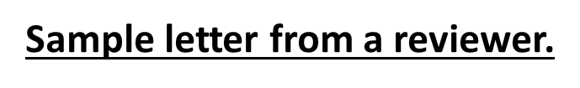
John Thomas,
1600 Pennsylvania ave,
Auckland.
30/4/2015.
To whom it may concern.
I have reviewed the accounts presented to me of the XYZ Ostomy Society for the year ending 31/3/2015 and have found that they are well presented, easy to understand and are a correct representation of the statements of accounts of the society.
I have reviewed the No1 (cheque account) and No2 investment account.
Yours faithfully,
John Thomas.

Slide 12
Statements of Income and expenditure
On the following slides I have simply left the same details as were used at the 2016
Federation of New Zealand training seminar in Wellington as they are really only an example
And you would simply put your own items (purchased or sold) in place of the items shown.
Those of you who do in fact have an accounting background will be aware of what I am showing.
I have tried to keep this as basic as possible as I am working on the premise that if you find something
Hard to understand then your association members will find it even harder.

Slide 17
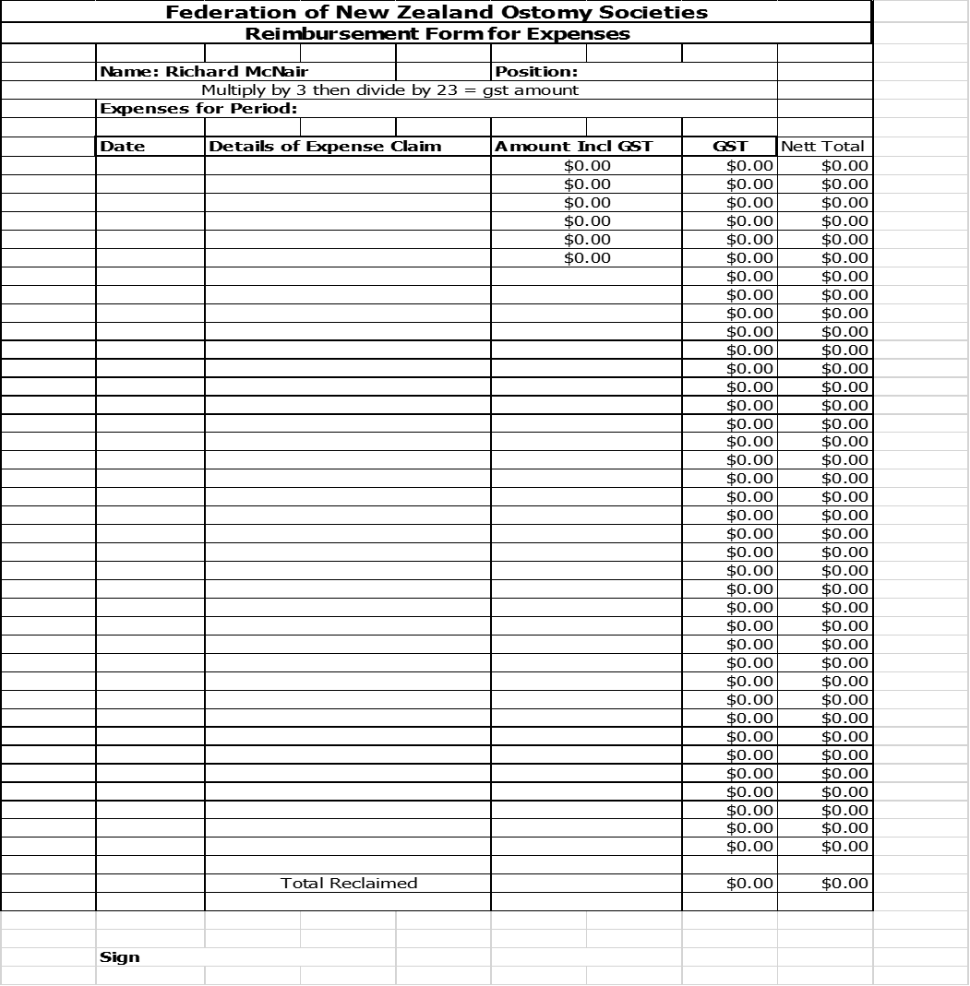

Slide 19
If in doubt then simply ask the ASPOA
Executive for advice – we are always available to help

Slide 20
SECRETARIAL DUTIES
RECORDS
MEMBERSHIP
CORRESPONDENCE
CONTACTS

Slide 21
MEMBERSHIP
It is important that your records are kept current
Please note that all members should have agreed to be a member and for you to keep their records
Keep the information to the minimum need to operate the society
Ensure it is protected and not open to the general public

Slide 22
Typical information Requirements
Title
First Name prefers to be know as
Family Name
Postal Address
Street Address
Home Phone Mobile
Home Email work Email

Slide 23
Membership Type
Ostomy Type
Age/DOB
Gender
Subscriptions Paid
Special Skills

Slide 24
Recording Membership
Basic Cards or Register
If using a computer or lap top
Excel Spreadsheet, Access Data Base or other Relational Data Base such as File Maker

Slide 25
Excel
Advantages
Simple database easy to set up and maintain
Records can be sorted by age or name
Records can be filtered to created lists to cover specific information e.g.
type of ostomy, persons gender, specific town of region
N.B. must be kept current

Slide 26
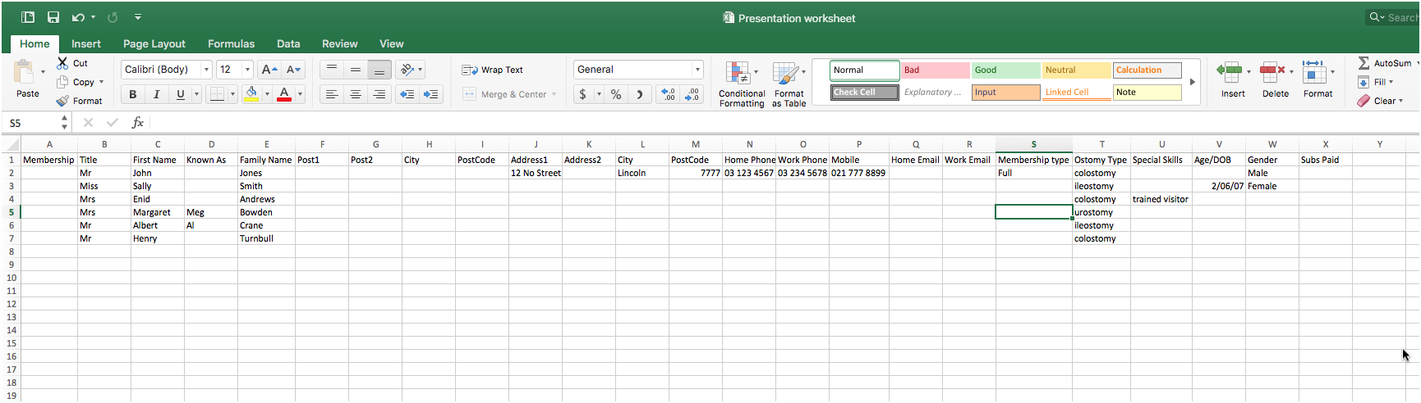

Slide 27
Disadvantages
Work sheet can become too large for easy viewing
Keep a Master,
Back up frequently/print out with date

Slide 28
Relational Database
Advantages
Can create special screens for inputting information
Reports can be tailored for specific purposes requiring to be set up once only
Disadvantage
Requires some level of competency and the software is not generally available as part of the normal packages.

Slide 29
Correspondence
Keep a register of all correspondence received and sent including emails of importance
And remember to keep copies
The records can be kept in a hard copy register or in a database.
Again a database can be kept in an Excel spreadsheet or in a Relational Databases

Slide 30
Discuss required actions with the President
Agenda for next meeting
Reply required?

Slide 31
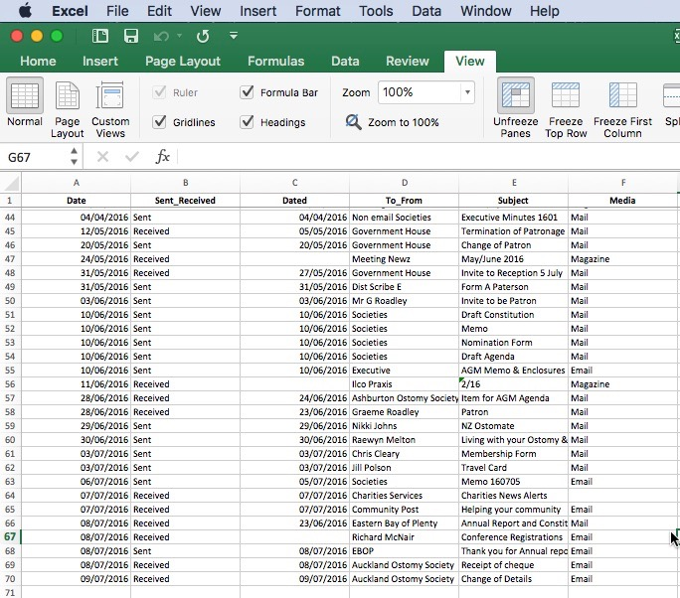
Excel

Slide 32
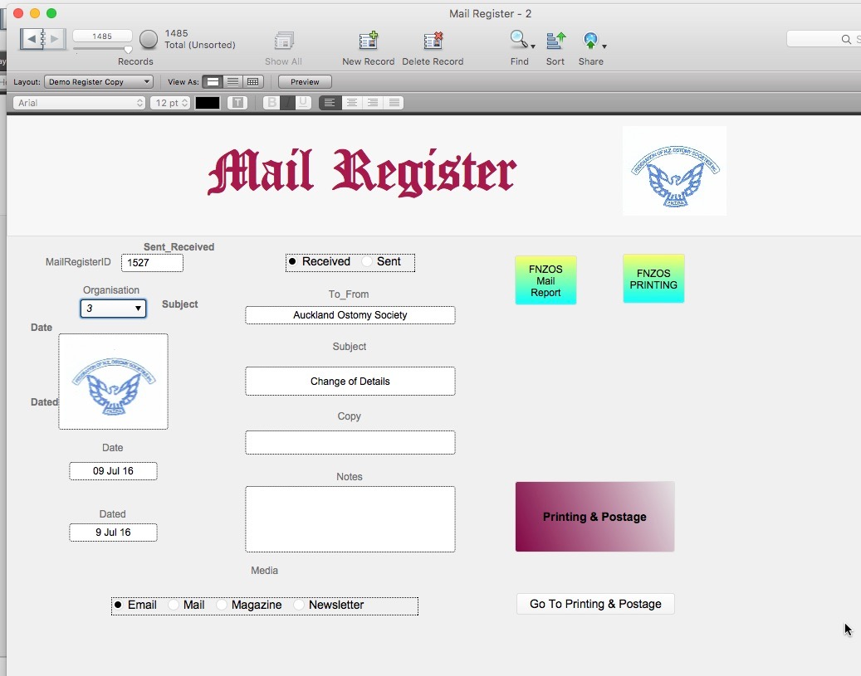
File Maker

Slide 33
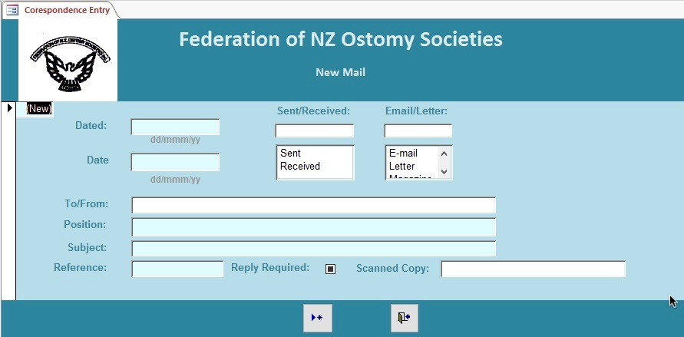
Access

Slide 34
Contacts
Maintain a Record of contacts including
  Stomal therapists
  Supply Reps
  Other useful contacts such as Cancer Society

Slide 35
OTHER DUTIES
Maintain the Society’s copy of the constitution/rules
Maintain Society details with the Registrar of Incorporated Societies and Charities Commission as appropriate
Ensure the local DHB and Cancer Society have the current details of your Society
Inform the NZ Ostomate Editor and secretary/Webmaster of any changes

Slide 36
REQUIREMENTS
Access to the internet and an email account are almost compulsory as Government Departments are making increasing use of the internet fro forwarding information.
Minimum requirement would be a PC /Laptop/Tablet with word processing and spreadsheet capability compatible with MS Office

Slide 37
I hope that this presentation has been of help to all here today and if anyone would like a copy sent to them by e-mail the please contact me requesting this on: richardmcnair02@gmail.com and I will be more than happy to send this to you.

