Slide 1

Korea Ostomy Association
Mar.31~Apr.1,2017

Slide 2
Contents
1. Status of Ostomates in Korea
2. Introduction of K.O.A
3. K.O.A activity

Slide 3
Demographics
1. Status of Ostomates in Korea
1-1 About Korea
1-1 About Korea
50 Million population in South
GNI 20,759 $ (source from Korea bank)
OECD, G20
Life expectency : 80.5 Age, expect over 65 Ages in 2018, 14.3%
Registered Ostomates : 14,000 (2015)
National health insurance reimbursement system
(source from KOSIS)
KOA member : 1,000

Slide 4
1-2 Registered Ostomates
2%
2%
1%
0%
2%
5%
Source from KOSIS

Slide 5
1-3 Average Age of Ostomates
Source from KOSIS

Slide 6
1-4 Ostomy operation cases
4%
4%
8%
Source from HIRA

Slide 7
1-5 Ostomy operation cases
Stoma cases increasing
Temporary vs. Permanent =8 : 2
Most of temporary cases are ileostomy.
Old age single family cases are increasing .(They do not have care giver so hard to change products by themselves.)
Short hospitalization period(5-7 days) : can not receive enough training for stoma care.

Slide 8
1-6 Reimbursement System in Korea
4 plate and 4 bags per week or 4one-pieces per week
6 plate and 6 bags per week or 6 one-pieces per week (baby, Dementia)
Co-Payment for cancer patient has been changed
    Ostomy bag & plates reimbursement scheme began since 2005
    Within 5 years after surgery → pay just 5% of reimbursement price
    Over 5 years after surgery → pay 20% of reimbursement price
    Ostomy accessories reimbursement since 2015

Slide 9
2-1 History of Korean Ostomates Association
2. Introduction of K.O.A
1985. Mar. 16 : Established K.O.A
1997. Feb. 5 : Incorporated Association approval by the Government
2003. Jul. 1 : Government approval ostomates as a disabled person
2005. Sep. : Ostomy bags & plates were classified as a reimbursement items.
2011. Oct. : Goverment support for ostomy products by the Disabled Person
Welfare Law

Slide 10
2-2 K.O.A in Province
Oneju KOA
Seoul main office
Daegu KOA
Daejun KOA
Jeungju KOA
Busan KOA
Kawngju KOA
Jinjun KOA
10

Slide 11
3. K.O.A Activity
3-1. Counseling
3-2. Stoma Seminar
3-3. Monthly Meeting
3-4. News- Letter
3-5. Picnics
3-6. Ostomy Products Donation
3-7. Lobby Activity for Ostomates Right.
3-8. Home Visiting Care
11

Slide 12
3-1 Counseling
3-1-1. Counseling with the Specialist
* Every Fri. 14:00 – 16:00
* Former Prof. of the Department of Nursing Science at Seoul National Uni.
(Mrs. Kim has done it for 32 years since establishing K.O.A)
3-1-2. Counseling with the Fellow
* Every Day 10:00 – 17:00(Mon day –Friday)
* President and Members of K.O.A
3-1-3. Counseling in Website of K.O.A (http://ostomy.or.kr)
3-1-4 Counseling in Online Community of Ostomates

Slide 13
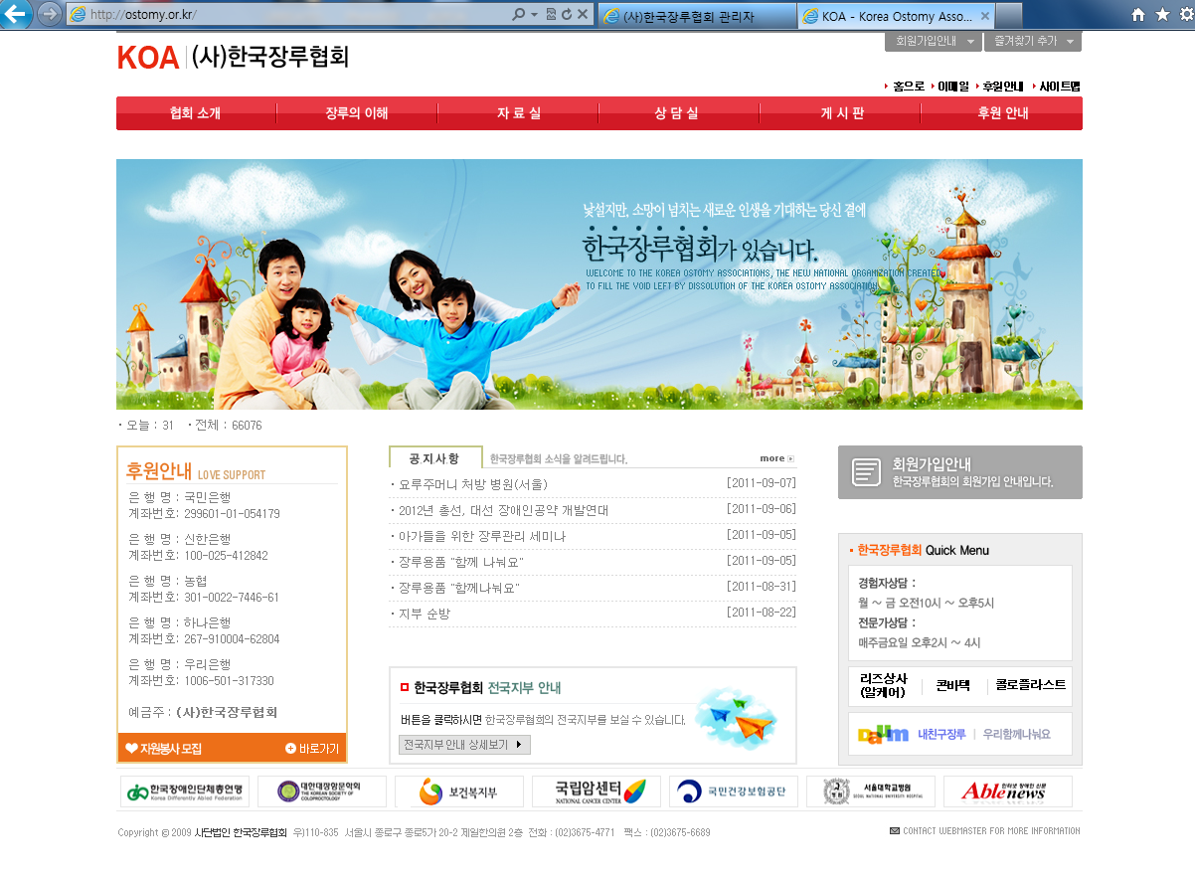

Slide 14
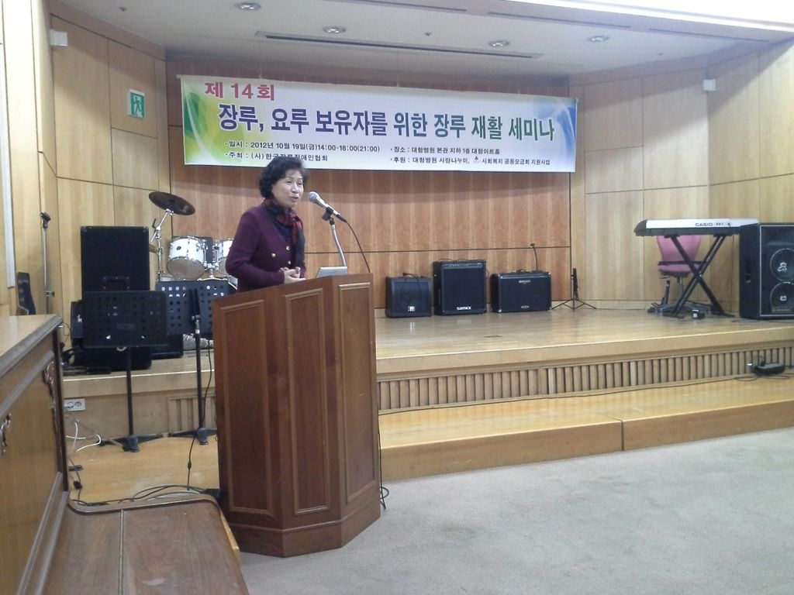
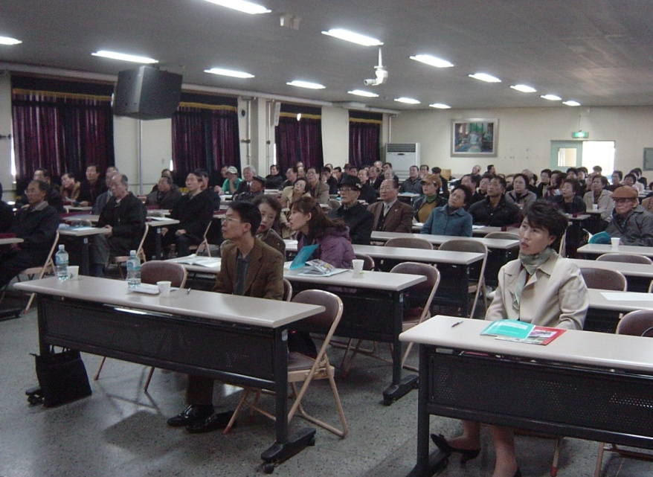
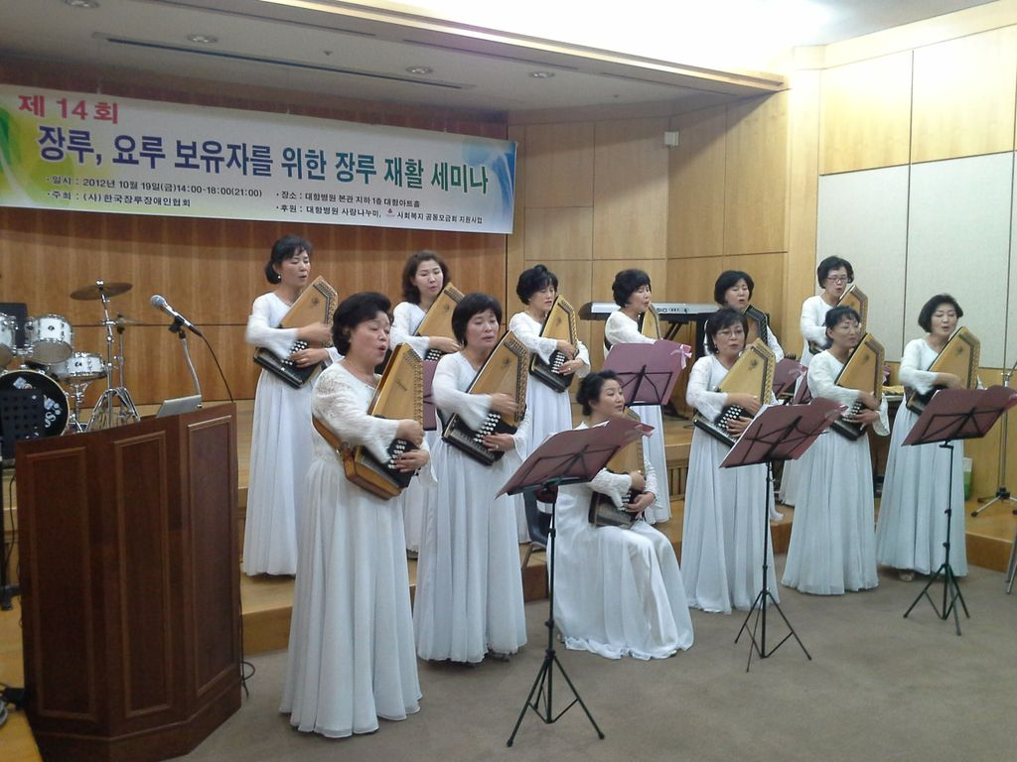
3-2. Stoma seminar
* Once a year, around Oct.
* Seminar with the famous Doctor for Coloproctology and Urology

Slide 15
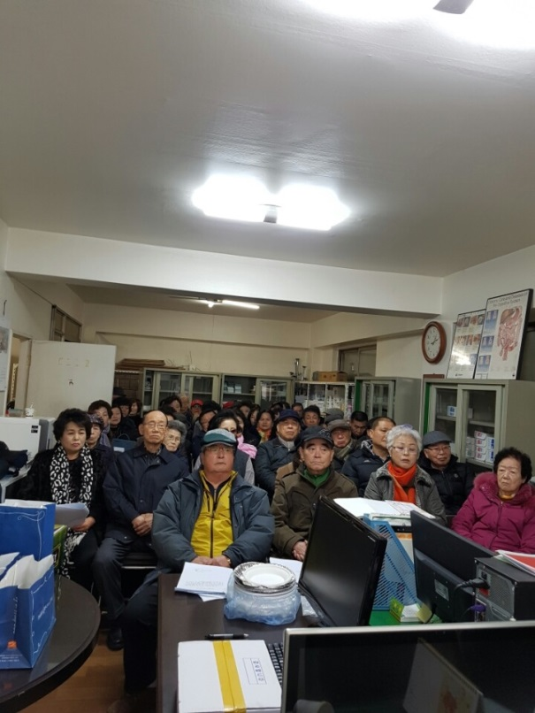
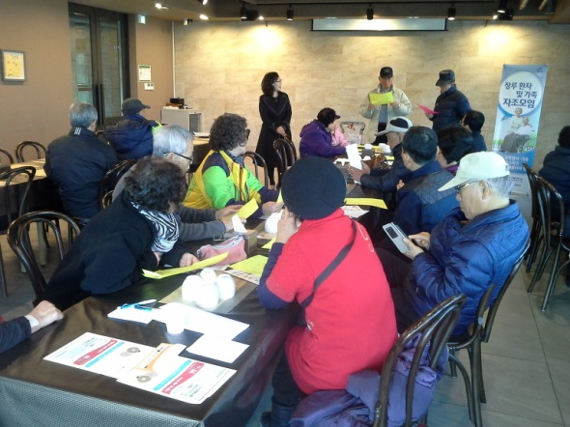
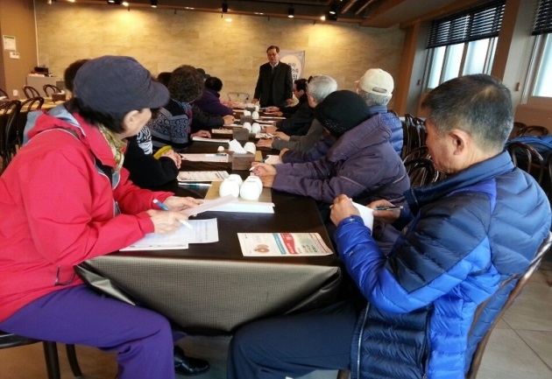
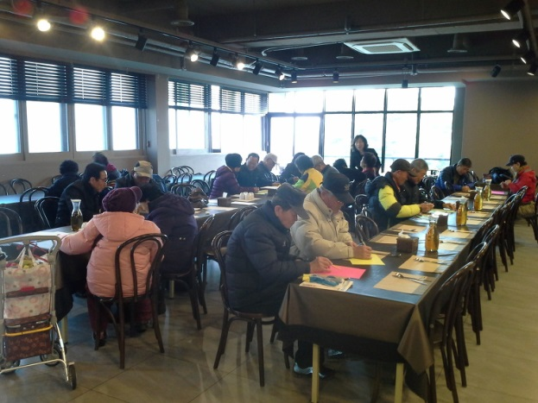
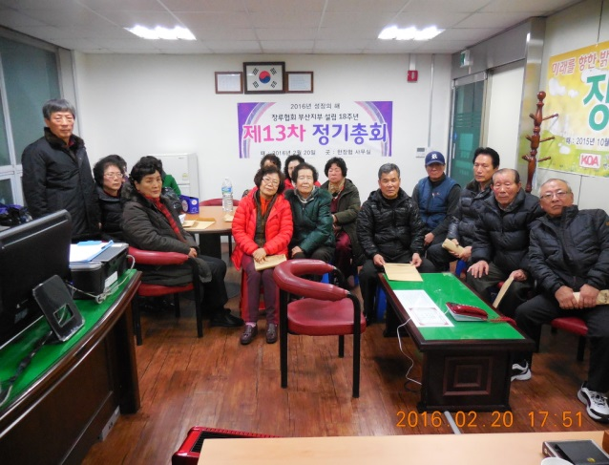
3-3. Monthly meeting
20 March 2017
15
Every branches have their own schedules for the meeting.
Provide news about stoma and have a good time with the members.

Slide 16
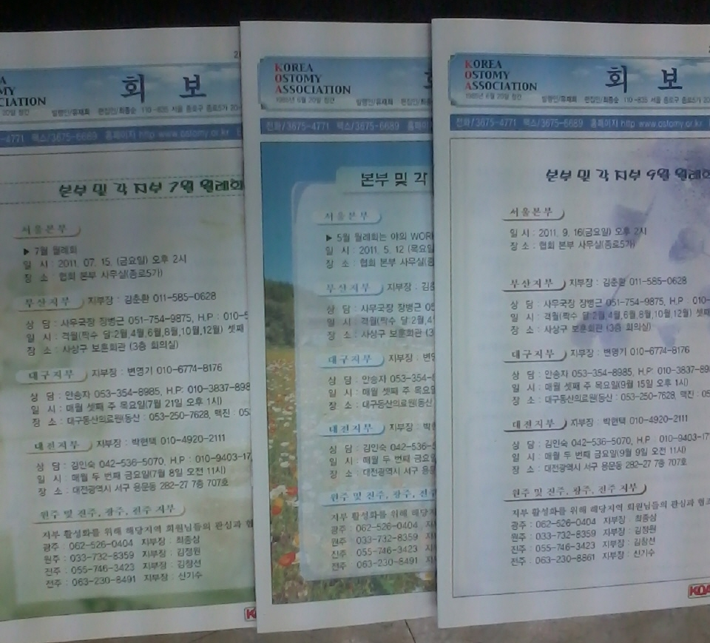
3-4. News-Letter
We have a Ostomy News-Letter monthly published

Slide 17
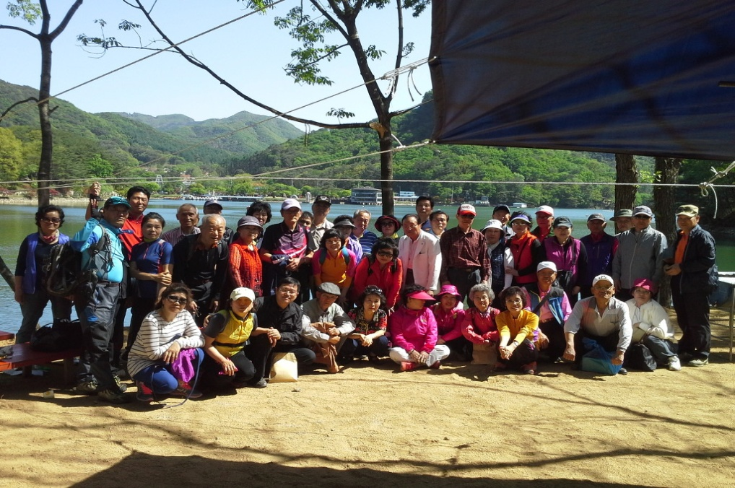
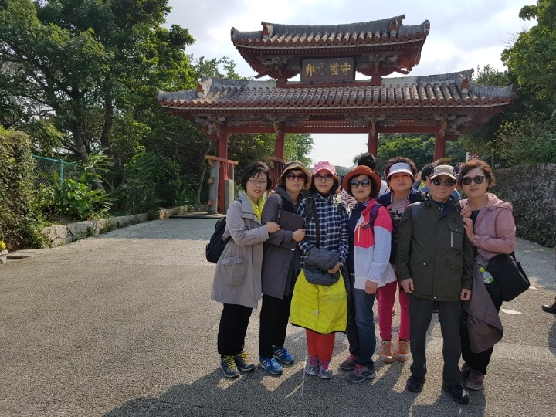
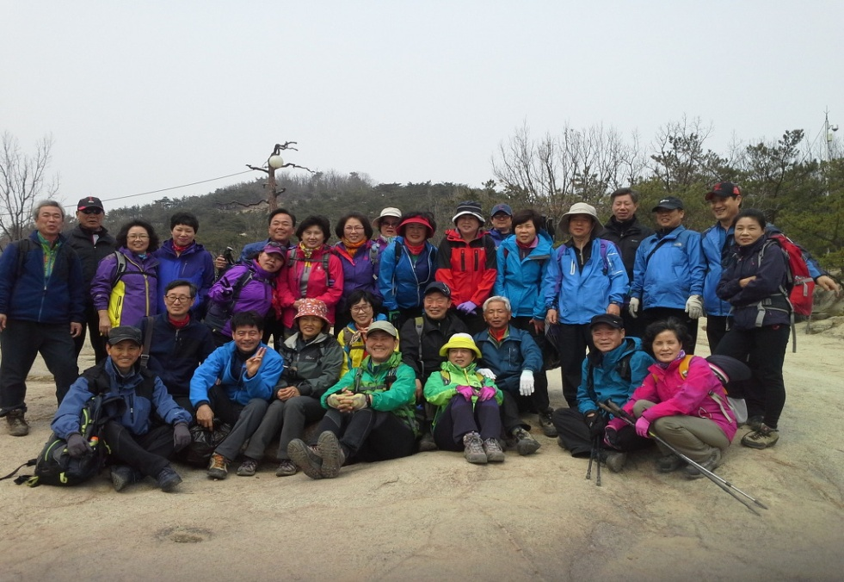
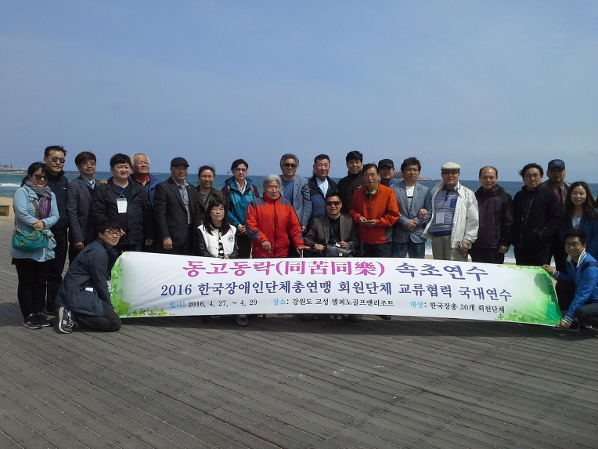
3-5. Picnics

Slide 18
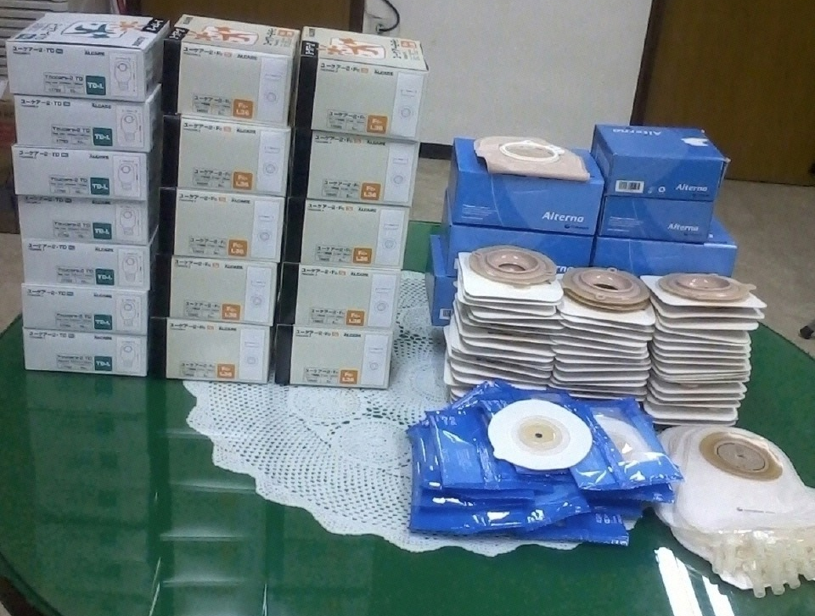
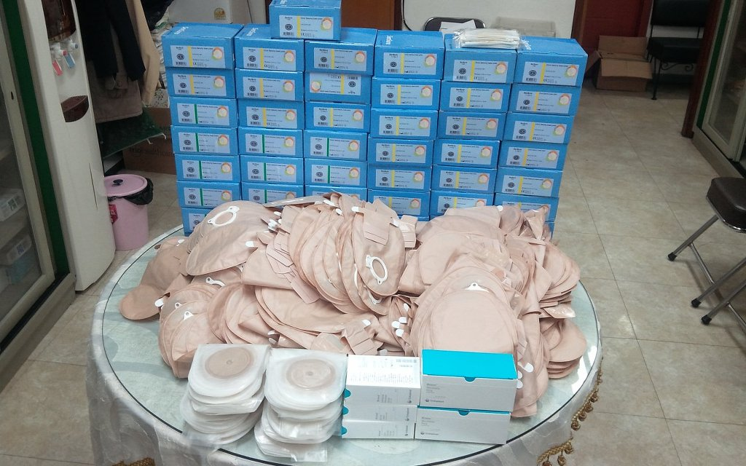
3-6. Ostomy products donation
20 March 2017
18
K.O.A members, products company donate ostomy products.
Send ostomates who need products.

Slide 19
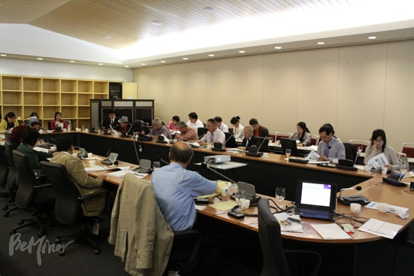
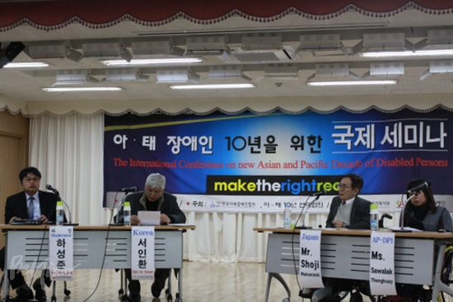
3-7. Lobby activity for Ostomates right.
Participate in many Disability Forums.
Ask and struggle against the Government for Welfare of Ostomates

Slide 20
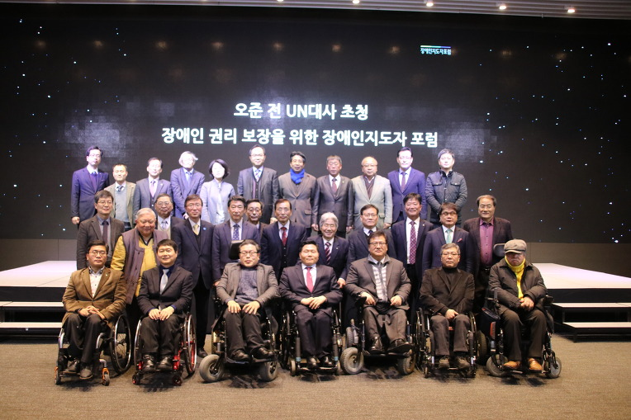
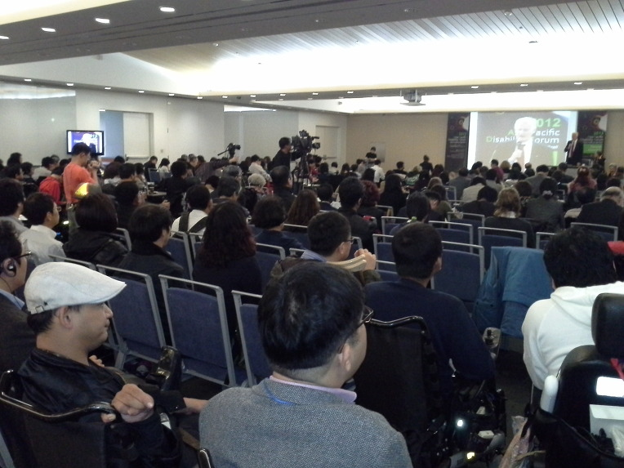
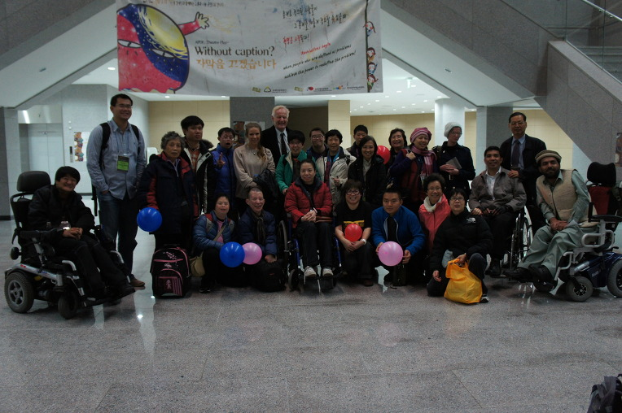
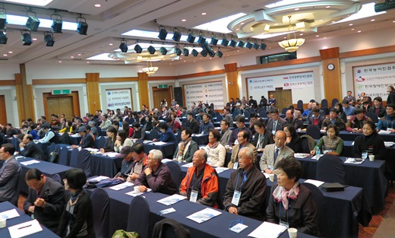

Slide 21
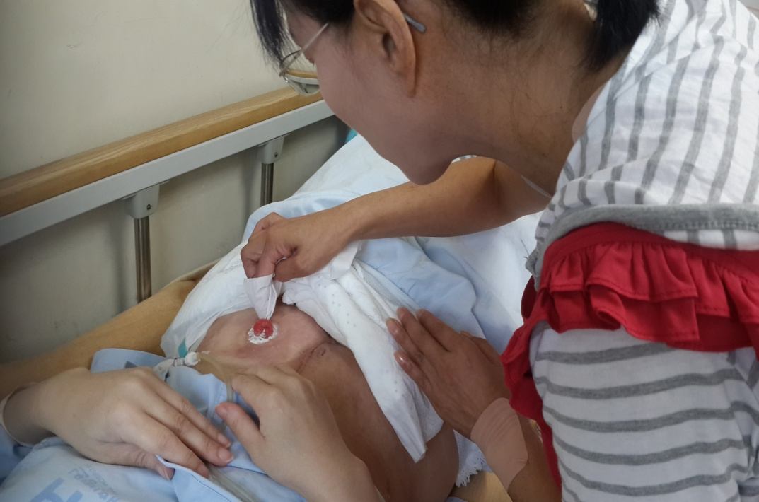
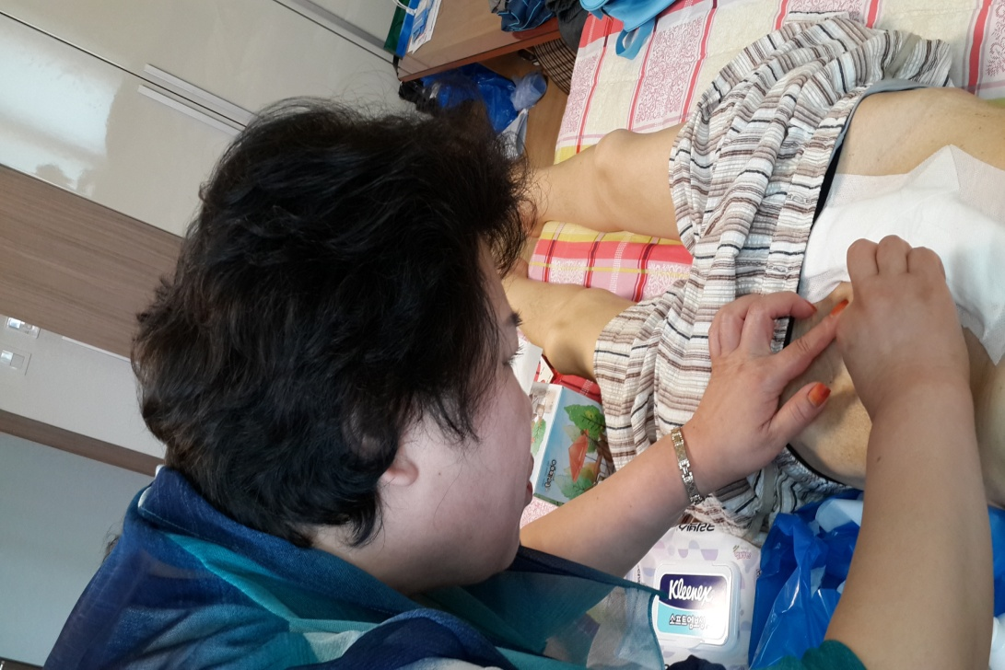
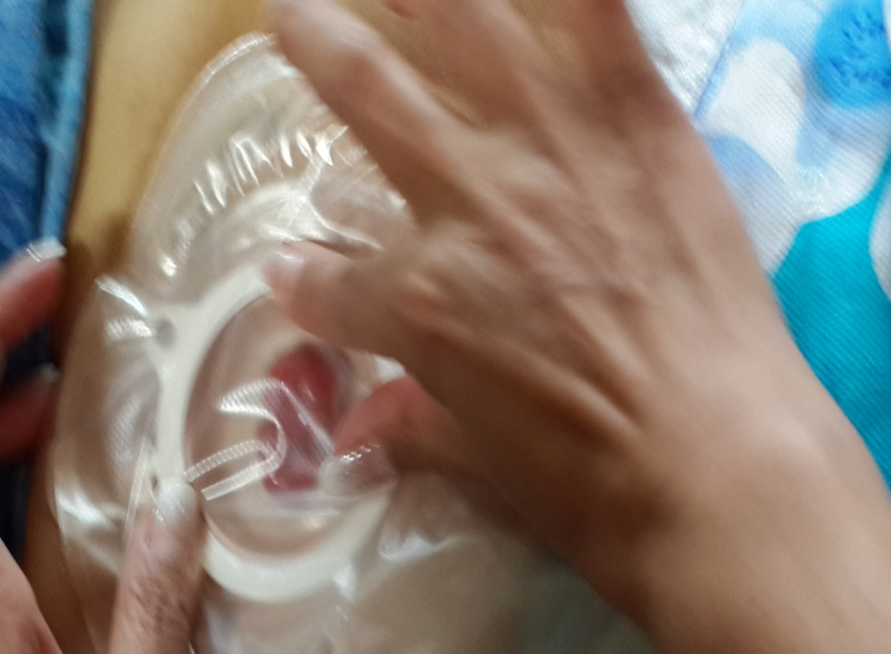
3-8 Home Visiting Care
* Visit homes of ostomates to care them.

Slide 22
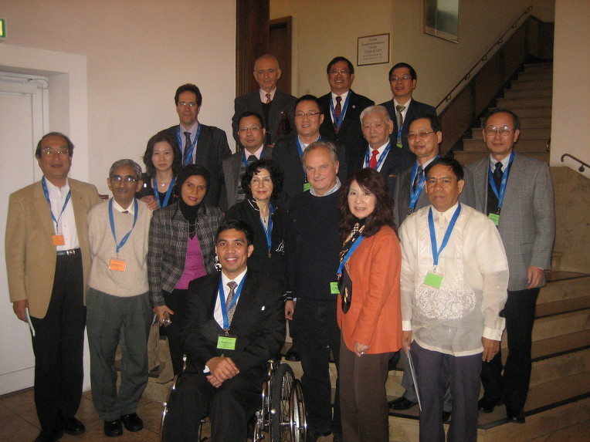
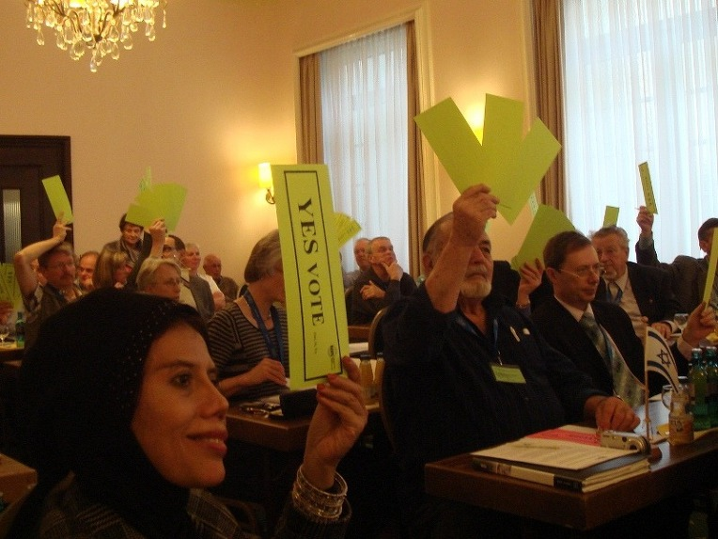
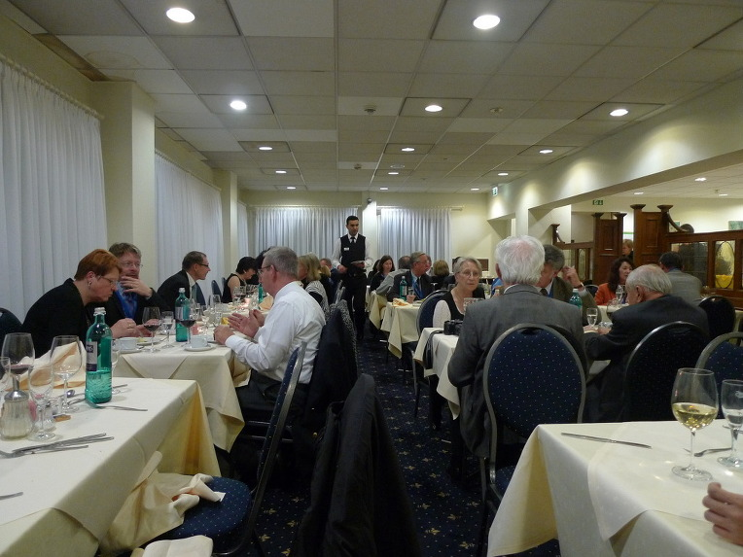
3-9 World Meetings
IOA General Meeting in Frankfurt, 2010

Slide 23
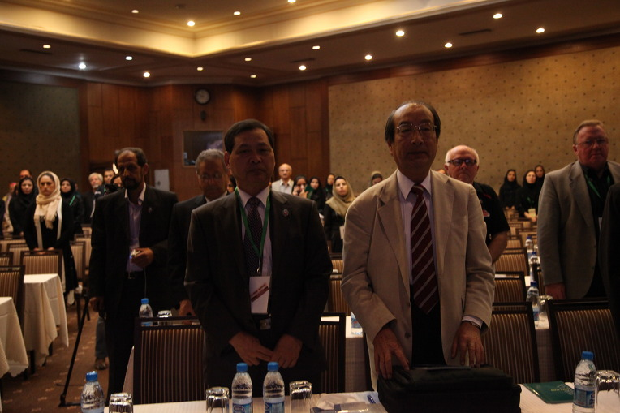
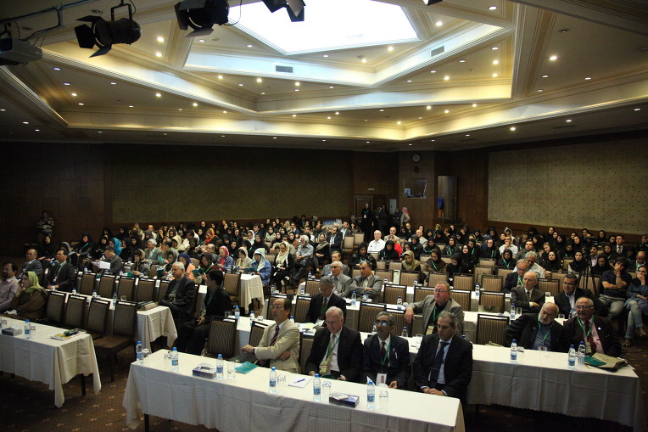
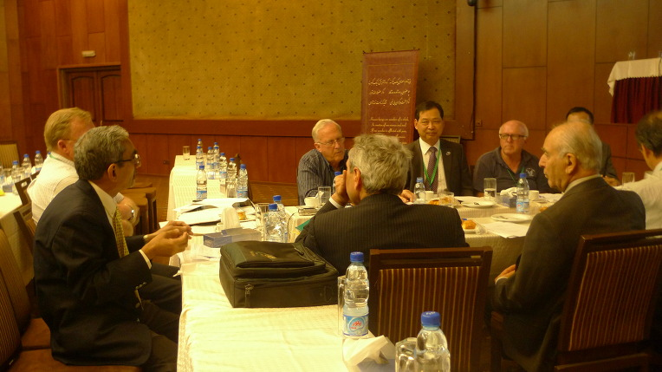
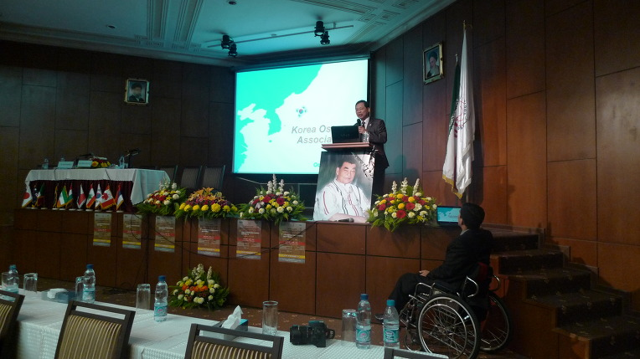
ASPOA General Meeting in Iran, 2011

