Slide 1
Ostomy Support Group
& The Roles of
Persatuan Ostomi
Malaysia (MOSA)
Rozita Mohamad
Committee Members Of MOSA

Slide 2
outLinE of presentation
Introduction
Roles
Activity
Challenges
Plan
Conclusion

Slide 3
introduction
Malaysian OStomy Association (MOSA)
known as Persatuan Ostomi Malaysia
PSCM is the first Ostomy association in
Malaysia and establish by a group of colorectal
surgeon @ HKL
Registered 13 April 2012,
(PPM-021-10-13042012)

Slide 4
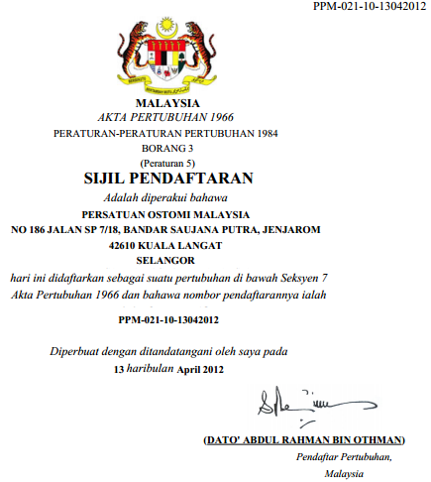

Slide 5
introduction
Information
Advocacy
Support channel
Update
Financial

Slide 6
Aims of mosa
Coordinate hospital & community resources
achieve comprehensive stoma care for new
patients both pre & post operatively as well
after discharge from hospital
To provide moral & physical support for
patients with stomas.
Provide opportunity for ostomate meet and
talk with people undergone Ostomies surgery.
To provide regular update on advances of
stoma care.

Slide 7
Association related to mosa

Slide 8
Activity
MOSA Council &General Meeting
Ostomates Gathering/visits
World Ostomy Day
Stoma Care Seminar
Community screening service
Membership drive
Dinner and Dance
Attend National and International
conferences/seminar/workshop

Slide 9
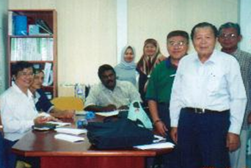
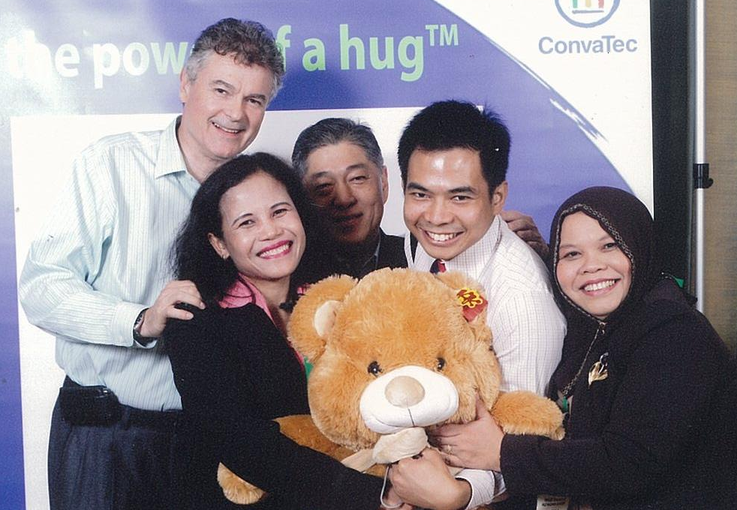
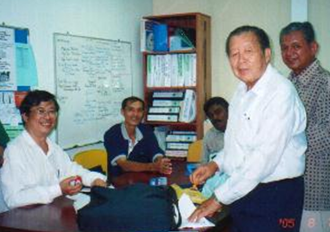
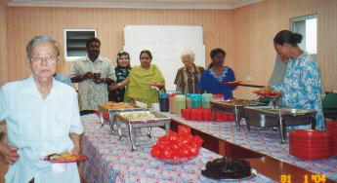
Activity

Slide 10
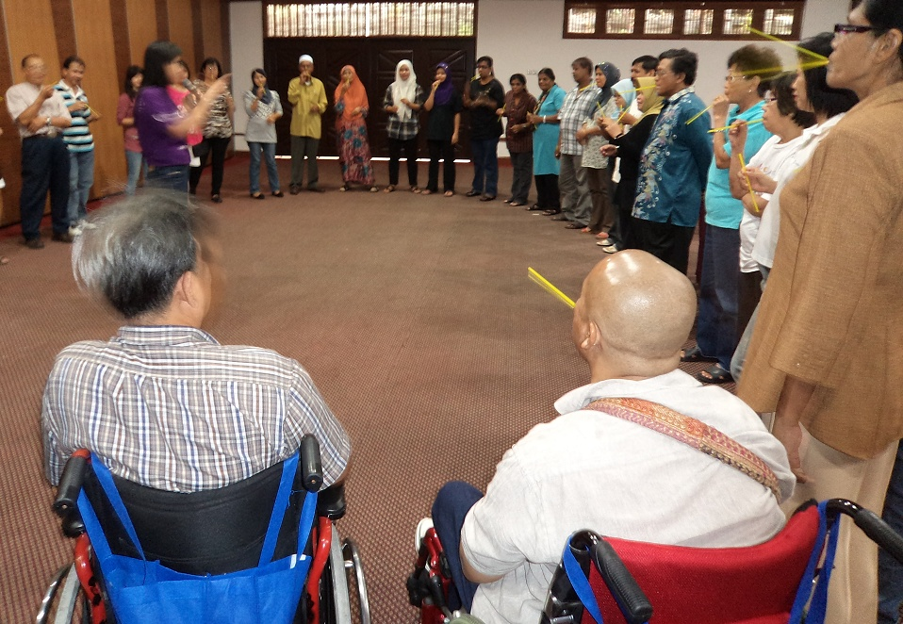
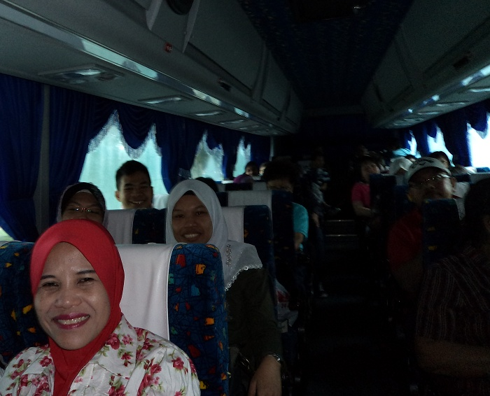
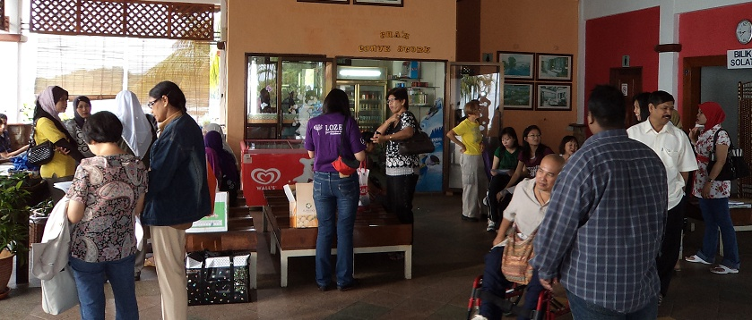
Activity

Slide 11
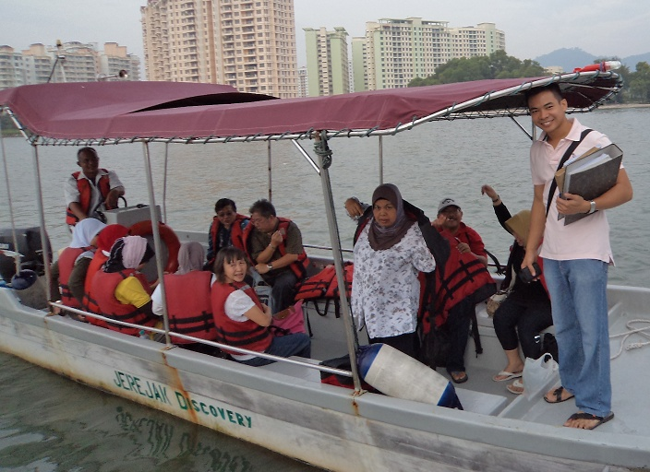
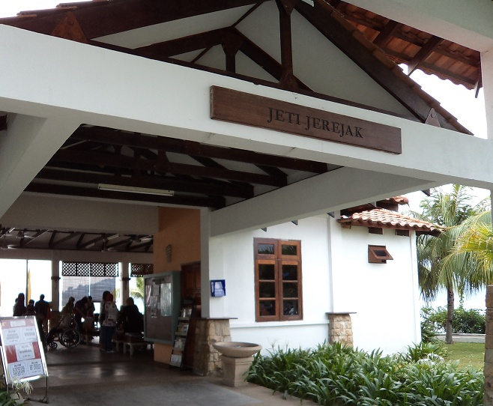
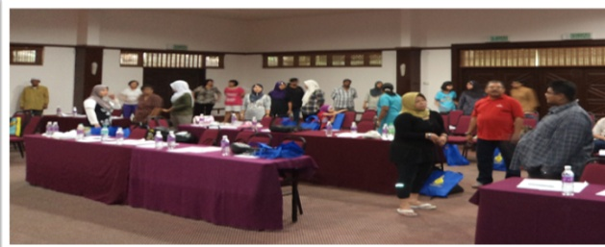
Activity

Slide 13
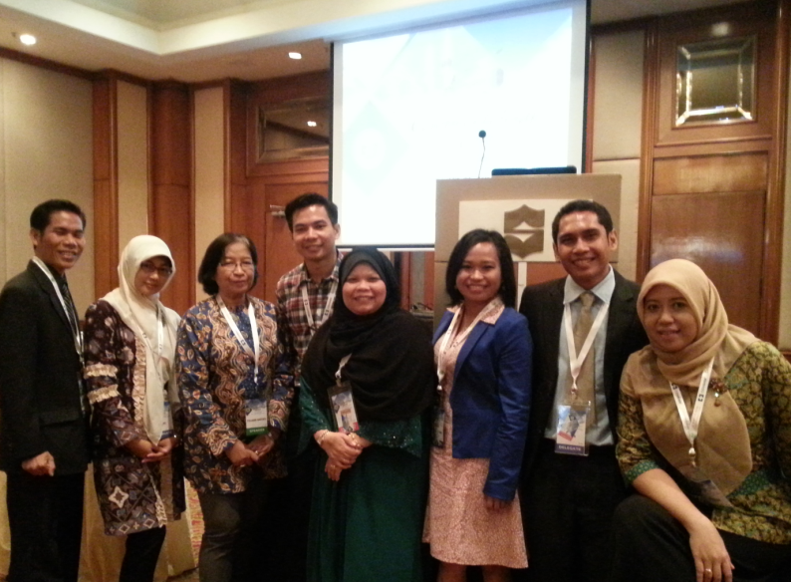
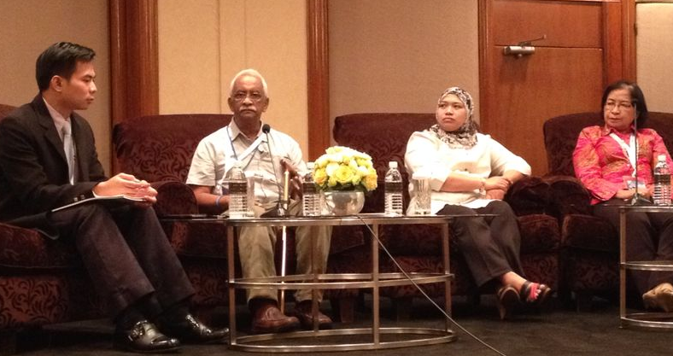

Slide 14
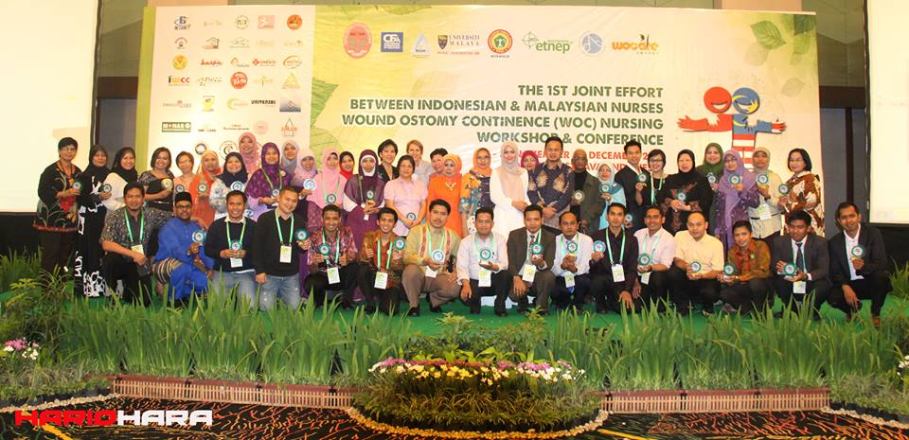
NETWORKING & Collaboration – exchange knowledge and experiences

Slide 15
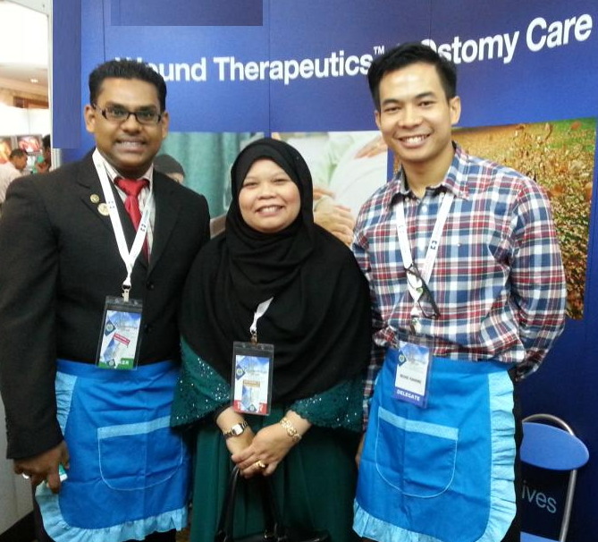
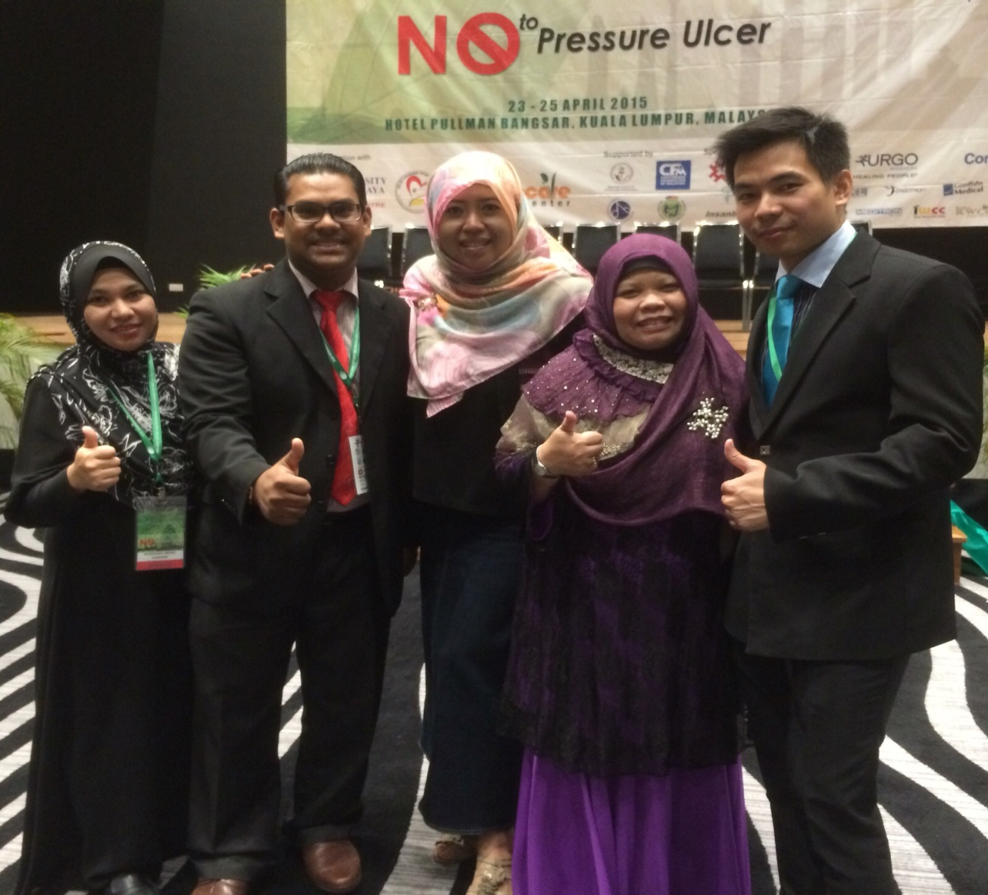
Consistent and maintain to built up skills

Slide 16
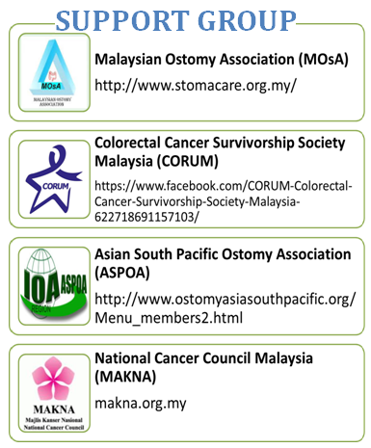

Slide 17
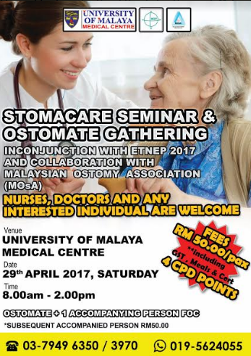
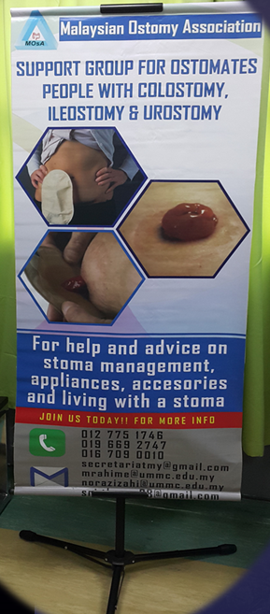
Let’s get them
Ostomates
Carrer
HCP
Public interest
Traders
Counsellor
Student
Event&activities
to help who in
needs!!

Slide 18
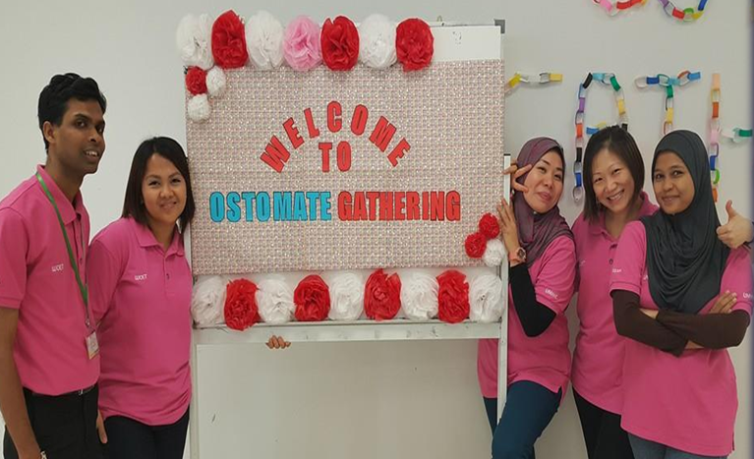
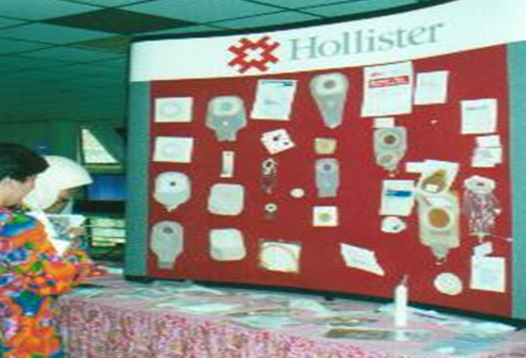

Slide 19
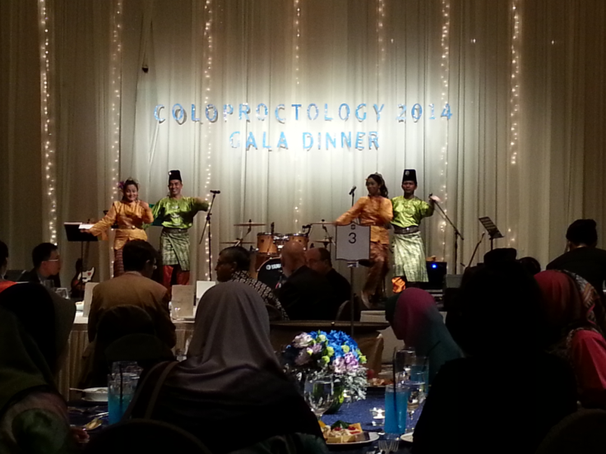

Slide 20
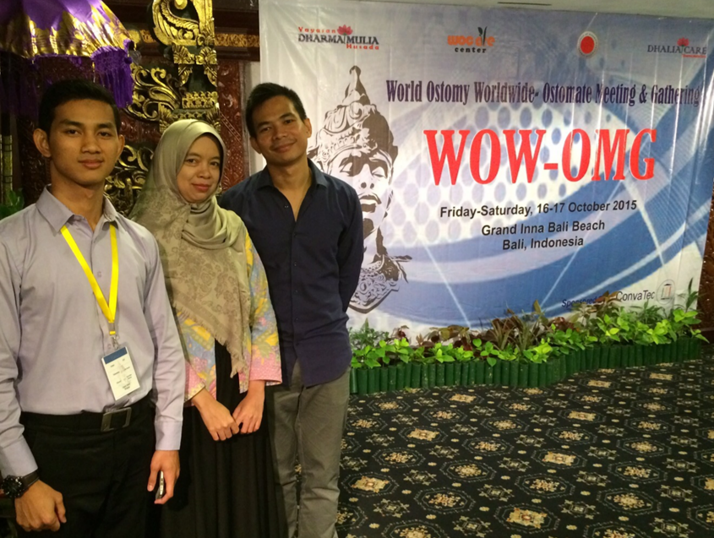
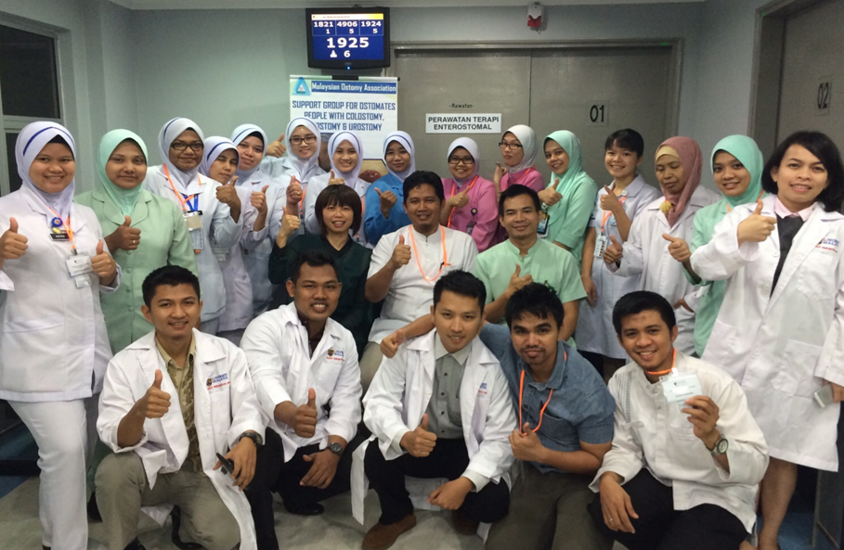

Slide 21
resources
www.ostomatesfamily.com
OSTOMY SUPPORT
FACEBOOK

Slide 22
challenges
Membership application by Ostomates
Association Fund
Application of Tax Exemption
by the LHDN
Support by Health Care Provider
Supporters by Ostomy Products

Slide 23
Future Planning
MOSA is more active nationally and participate
in International bodies such as ASPOA
Centre of Ostomy Support activity
Financial support for ostomates who in need
Take part actively in Stoma Care Research
Actively involved in Ostomy conference
Collaboration with Ostomy Product Company
with products updates
Celebrate World Ostomy Day

Slide 24
Conclusion
MOsA committed to the improvement quality of
life of Ostomates & those with related surgeries, worldwide. Our aim provides ostomates information and management guidelines, help and advocates on all related matters to Ostomy.
Maintaining the support group as to ensure it is relevant and able to function effectively, since it involves commitment, dedication and also good financial status, will need a lot of team work and hard work.

Slide 25
Conclusion
Collaboration and support between healthcare providers towards caring of ostomies group is the key to improving and sharing the best care for all of them.
WE COUNT ON YOU

Slide 26
THANK YOU!

